Slide 1

Bitcoin PRICE PREDICTION

Slide 2
WHAT IS BITCOIN
Bitcoin is a cryptocurrency and worldwide payment system. It is the first decentralized digital currency, as the system works without a central bank or single administrator.
Blockchain technology is a decentralized database system that was first implemented by Bitcoin. Created by a mysterious person (or group), Blockchain has a very high tendency to transform modern day business operation models. As Bitcoin gains more traction, people keep coming up with alternate coins that are also based on Blockchain technology.
Bitcoins can be used to buy merchandise anonymously. In addition, international payments are easy and cheap because bitcoins are not tied to any country or subject to regulation.

Slide 3
GOAL
Goal is to find a model where we can predict the value of Bitcoin considering all the factors which influences the price.
Why Bitcoin price prediction?
High volatile and so becomes very difficult to predict
Very high returns than the conventional financial trading

Slide 4
FACTORS THAT INFLUENCE BITCOIN
Reddit Metrics - Reddit Metrics Cryptos are associated with their reddit pages. It's where crypto investors come to discuss the merits of different blockchain implementations, dissect the day's main talking points. We can combine reddit metrics (total number of subscribers, new subscribers, rank -literally scraped from the reddit metrics website) and other crypto data.
Google Trends – Looking at google searches and coin prices.
Stock Market Prices - Looking at the stock market may provide clues as to how the general economy is performing, or even how specific industries are responding to the blockchain revolution. This analysis scrapes yahoo finance and returns historical daily data.
Commodity Prices – Looking at Bitcoin and the more traditional stores of value (gold)
Oil Prices - Looking at Bitcoin and the oil prices
Social Media (Twitter) - Looking at Bitcoin and the sentiment analysis

Slide 5
DATA COLLECTION
Collected the following types of data:-
Crypto Compare (cryptocompare.com)
Bitcoin Data Quandl (Quand.com)
Google Trends using Pytrends API
Twitter data using API
Stock Market Prices (finance.yahoo.com)
Commodity Prices (kitco.com)
Oil Prices (eia.gov)
Reddit Metrics (redditmetrics.com)

Slide 6
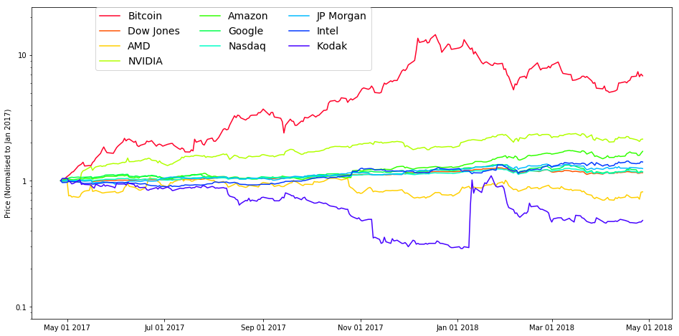
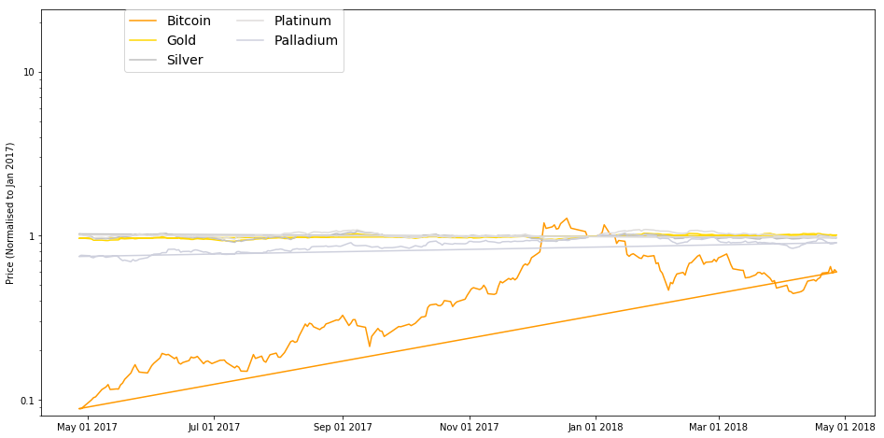
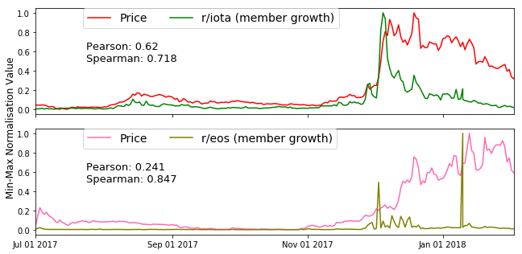
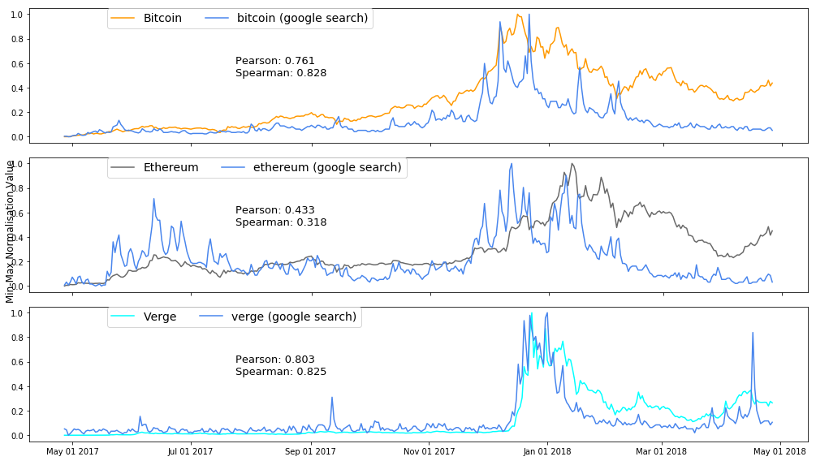
EXPLORATORY

Slide 7
DATA PRE-PROCESSING
Reddit/Tweets
Tokenizing
Sentiment Analysis
Google Trends
Search Frequency
Merge
CoinDesk API
Bitcoin Price
Merge
Stock Market
Commodity
Oil
Stock Prices
Commodity Prices
Oil Prices
Merge
Feature Vector

Slide 8
PREDICTIVE ANALYSIS
Two types of models:
Traditional time-series ARIMA model
Deep Learning Model

Slide 9
ARIMA MODEL
Autoregressive Integrated Moving Average – Time Series Model
With lag = 24
With difference order = 1 to make the series stationary
With moving average =1
Train/Test: 70/30
Steps | Exogeneous Variables | MSE
1 -100 | 6 | 0.000039
101-600 | 6 | 0.000918
Steps | Exogeneous Variables | MSE
1 -100 | 3 | 0.000036
101-600 | 3 | 0.000118

Slide 10
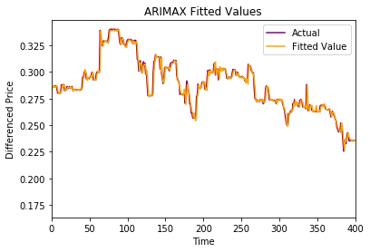
ARIMA MODEL
ARIMA PLOTS & PERFORMANCE
Mean Squared Error : 0.000036

Slide 11
DEEP LEARNING MODEL - PERFORMANCE
Simple sequence to sequence to model
100 hidden dimension for Encoder and Decoder LSTM
KERAS and Tensor Flow
Adam Optimizer|100 Batchsize|300 epochs
Loss Function: Minimize Mean Squared Loss
RESULT
Input Sequence Length | RMSE
Lookback = 1 | 4.653
Lookback = 2 | 4.906
Lookback = 3 | 5.009

Slide 12
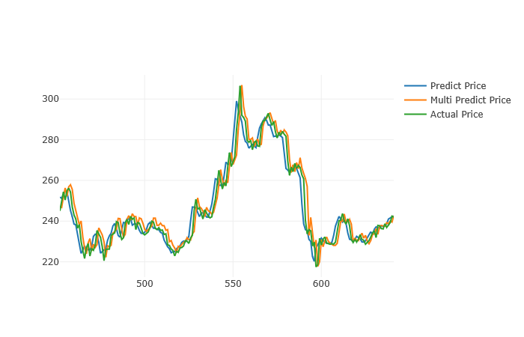
DEEP LEARNING MODEL
PREDICTION PLOTS

